Slide 1
CSE 4101
Lecture 9
Topic: Search and Control Strategies

Slide 2
Introduction
Search can be characterized as finding a path through a graph or tree structure. This requires moving from node to node after successively expanding and generating connected nodes. Once this is done, a child is said to be generated and the parent is said to be explored. The process of generating all of the children of a parent is also known as expanding the node. A search procedure is a strategy for selecting the order in which nodes are generated and a given path selected.

Slide 3
Introduction
Search problems may be classified by the information used to carry out a given strategy.
In blind or uninformed search, no preference is given to the order of successor node generation and selection. The path selected is blindly or mechanically followed. No information is used to determine the preference of one child over another.
In informed or directed search, some information about the problem space is used to compute a preference among the children for exploration and expansion.

Slide 4
Problem Space
Problem Space refers to the entire range of components that exist in the process of finding a solution to a problem. This range starts with “defining the problem,” then proceeds to the intermediate stage of “identifying and testing possible solutions” and ends with the final stage of “choosing and implementing a solution”. Plus, it includes all of the smaller steps that exist between these identified stages.

Slide 5
Problem Space
A simple example of this might be realizing that you don’t have the right clothes for a social event, identifying what you need and where to go to buy the appropriate clothes and then buying those clothes and bringing them home. In between these stages you also have to take into consideration other associated concerns like "what can I afford? What stores carry what I want to buy?" and then "how do I find the time to shop for what I'm looking for?"

Slide 6
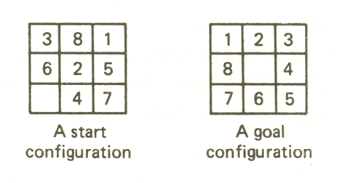
Example of Search Problem
The Eight Puzzle
are numbered from 1 to 8. One square is empty, permitting tiles to be shifted. The objective of the puzzle is to find a sequence of tile movements that leads from a starting configuration to a goal configuration such as that shown in Figure.

Slide 7
The Eight Puzzle
The states of the eight puzzle are the different transformations of the tiles within the frame. The operations are the permissible moves: up, down, left, and right. An optimal or good solution is one that maps the eight puzzle consists of a 3-by-3 square frame which holds eight movable square tiles which initial arrangement of tiles to the goal configuration with the smallest number of moves.

Slide 8
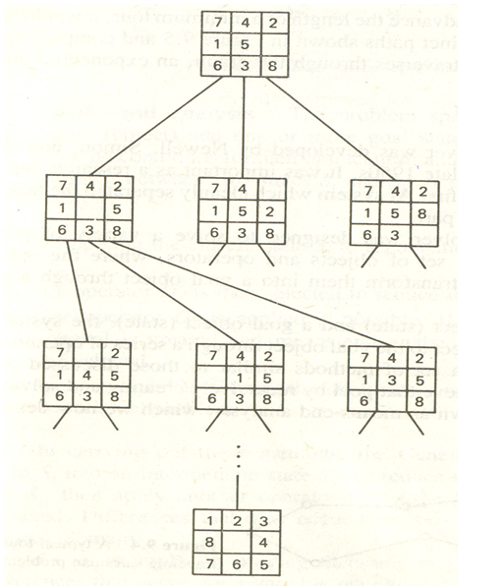
The eight puzzle
The search space for the eight puzzle problem may be depicted as the tree shown in Figure below.

Slide 9
The eight puzzle
In the figure, the nodes are depicted as puzzle configurations. The root node represents a randomly chosen starting configuration, and its successor nodes correspond to the three single tile movements that are possible from the root. A path is a sequence of nodes starting from the root and progressing downward to the node.

Slide 10
Travelling Salesman Problem
The Traveling Salesman Problem was first formulated in 1930 by Merrill M. Flood, who looked to solve a school bus routing problem.
"Given a list of cities and the distances between each pair of cities, what is the shortest possible route that visits each city exactly once and returns to the origin city?"

Slide 11
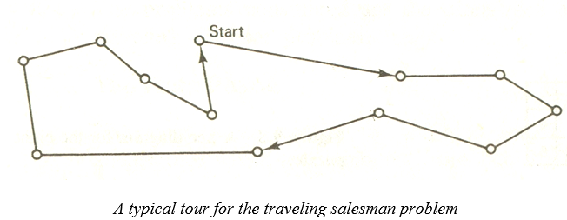
Travelling Salesman Problem
The traveling salesman problem involves n cities with paths connecting the cities. A tour is any path which begins with some starting city, visits each of the other cities exactly once, and returns to the starting city. A typical tour is depicted in figure below.

Slide 12
Travelling Salesman Problem
Travelling salesman problem is classified as “NP-hard” because of two reasons:
There are no quick solutions.
The complexity of calculating the most optimum route increases when you add more destinations to the TSP.
You can solve the TSP by analyzing every round-trip route to determine the shortest one.

Slide 13
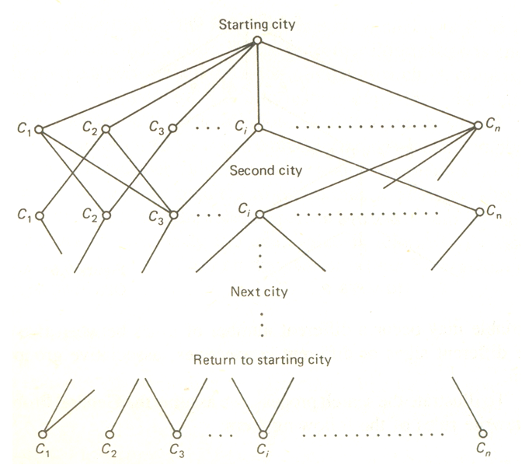
Travelling Salesman Problem

Slide 14
Travelling Salesman Problem
A set of ten destinations alone can have more than 300 thousand permutations and combinations of routes. A set of 15 destinations can have more than 87 billion possible routes.
Most Popular Solutions for the Traveling Salesman Problem:
  The Brute-Force/Naive Approach
  The Branch-and-Bound Method
  The Nearest Neighbor Method

Slide 15
An example solution of travelling Salesman Problem
  The Brute-Force/Naive Approach
The Brute-Force Approach calculates and compares all possible permutations of routes to find the shortest unique solution.
The steps involved in solving the TSP using the Brute-Force Approach include:
  Calculating the total number of routes
  Drawing and listing all possible routes
  Calculating the distance traveled in each route
  Choosing the shortest route, which is the optimal solution

Slide 16
End

